Slide 1
Chapter 15
Advanced Normalization
Pearson Education © 2009

Slide 2
Chapter 15 - Objectives
How inference rules can identify a set of all functional dependencies for a relation.
How Inference rules called Armstrong’s axioms can identify a minimal set of useful functional dependencies from the set of all functional dependencies for a relation.
Pearson Education © 2009

Slide 3
Chapter 15 - Objectives
Normal forms that go beyond Third Normal Form (3NF), which includes Boyce-Codd Normal Form (BCNF), Fourth Normal Form (4NF), and Fifth Normal Form (5NF).
How to identify Boyce–Codd Normal Form (BCNF).
How to represent attributes shown on a report as BCNF relations using normalization.
Pearson Education © 2009

Slide 4
Chapter 15 - Objectives
Concept of multi-valued dependencies and Fourth Normal Form (4NF).
The problems associated with relations that break the rules of 4NF.
How to create 4NF relations from a relation, which breaks the rules of to 4NF.
Pearson Education © 2009

Slide 5
Chapter 15 - Objectives
Concept of join dependency and Fifth Normal Form (5NF).
The problems associated with relations that break the rules of 5NF.
How to create 5NF relations from a relation, which breaks the rules of 5NF.
Pearson Education © 2009

Slide 6
More on Functional Dependencies
The complete set of functional dependencies for a given relation can be very large.
Important to find an approach that can reduce the set to a manageable size.
Pearson Education © 2009

Slide 7
Inference Rules for Functional Dependencies
Need to identify a set of functional dependencies (represented as X) for a relation that
is smaller than the complete set of functional dependencies (represented as Y) for that relation, and
has the property that every functional dependency in Y is implied by the functional dependencies in X.
Pearson Education © 2009

Slide 8
Inference Rules for Functional Dependencies
The set of all functional dependencies that are implied by a given set of functional dependencies X is called the closure of X, written X⁺ .
A set of inference rules, called Armstrong’s axioms, specifies how new functional dependencies can be inferred from given ones.
Pearson Education © 2009

Slide 9
Inference Rules for Functional Dependencies
Let A, B, and C be subsets of the attributes of the relation R. Armstrong’s axioms are as follows:
(1) Reflexivity
If B is a subset of A, then A → B
(2) Augmentation
If A → B, then A,C → B,C
(3) Transitivity
If A → B and B → C, then A → C
Pearson Education © 2009

Slide 10
Inference Rules for Functional Dependencies
Further rules can be derived from the first three rules that simplify the practical task of computing X+. Let D be another subset of the attributes of relation R, then:
(4) Self-determination
A → A
(5) Decomposition
If A → B,C, then A → B and A → C
Pearson Education © 2009

Slide 11
Inference Rules for Functional Dependencies
(6) Union
If A → B and A → C, then A → B,C
(7) Composition
If A → B and C → D then A,C → B,D
Pearson Education © 2009

Slide 12
Minimal Sets of Functional Dependencies
A set of functional dependencies Y is covered by a set of functional dependencies X, if every functional dependency in Y is also in X+; that is, every dependency in Y can be inferred from X.
A set of functional dependencies X is minimal if it satisfies the following conditions:
Every dependency in X has a single attribute on its right-hand side.
Pearson Education © 2009

Slide 13
Minimal Sets of Functional Dependencies
We cannot replace any dependency A → B in X with dependency C → B, where C is a proper subset of A, and still have a set of dependencies that is equivalent to X.
We cannot remove any dependency from X and still have a set of dependencies that is equivalent to X.
Pearson Education © 2009

Slide 14
Boyce–Codd Normal Form (BCNF)
Based on functional dependencies that take into account all candidate keys in a relation, however BCNF also has additional constraints compared with the general definition of 3NF.
Boyce–Codd normal form (BCNF)
A relation is in BCNF if and only if every determinant is a candidate key.
Pearson Education © 2009

Slide 15
Boyce–Codd Normal Form (BCNF)
Difference between 3NF and BCNF is that for a functional dependency A → B, 3NF allows this dependency in a relation if B is a primary-key attribute and A is not a candidate key.
Whereas, BCNF insists that for this dependency to remain in a relation, A must be a candidate key.
Every relation in BCNF is also in 3NF. However, a relation in 3NF is not necessarily in BCNF.
Pearson Education © 2009

Slide 16
Boyce–Codd Normal Form (BCNF)
Violation of BCNF is quite rare.
The potential to violate BCNF may occur in a relation that:
contains two (or more) composite candidate keys;
the candidate keys overlap, that is have at least one attribute in common.
Pearson Education © 2009

Slide 17
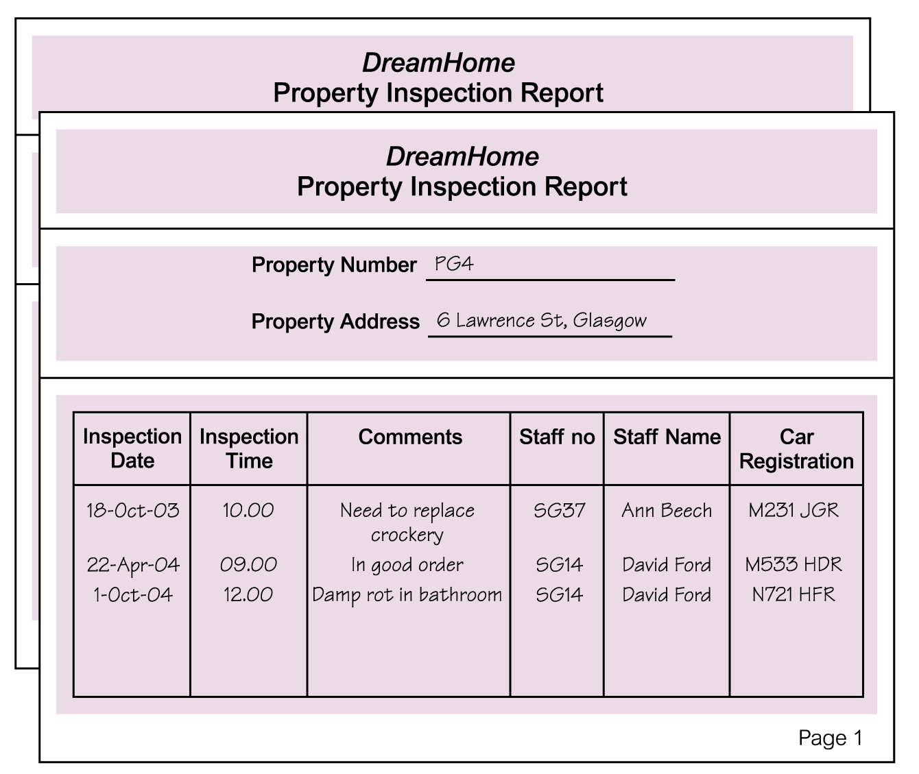
Review of Normalization (UNF to BCNF)
Pearson Education © 2009

Slide 18
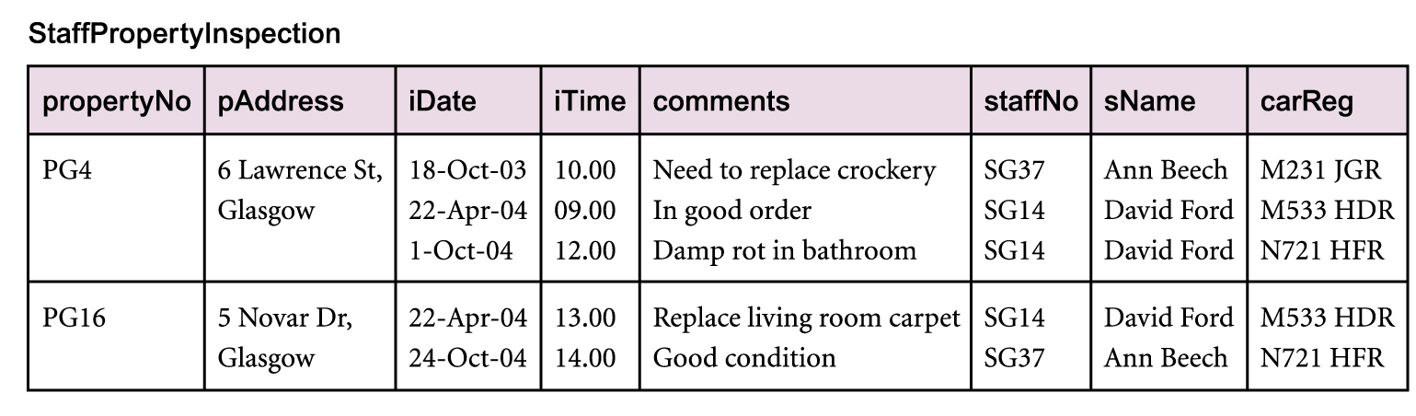
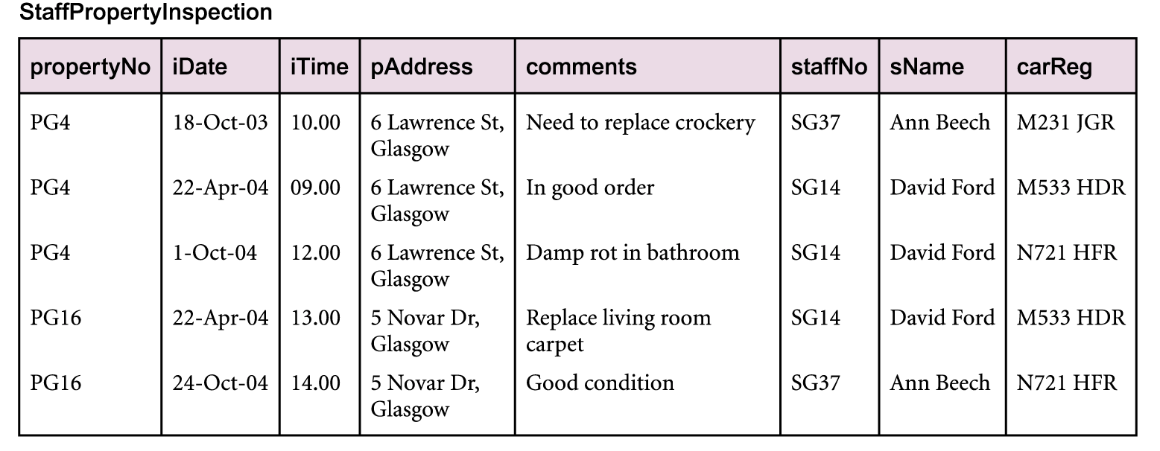
Review of Normalization (UNF to BCNF)
Pearson Education © 2009

Slide 19
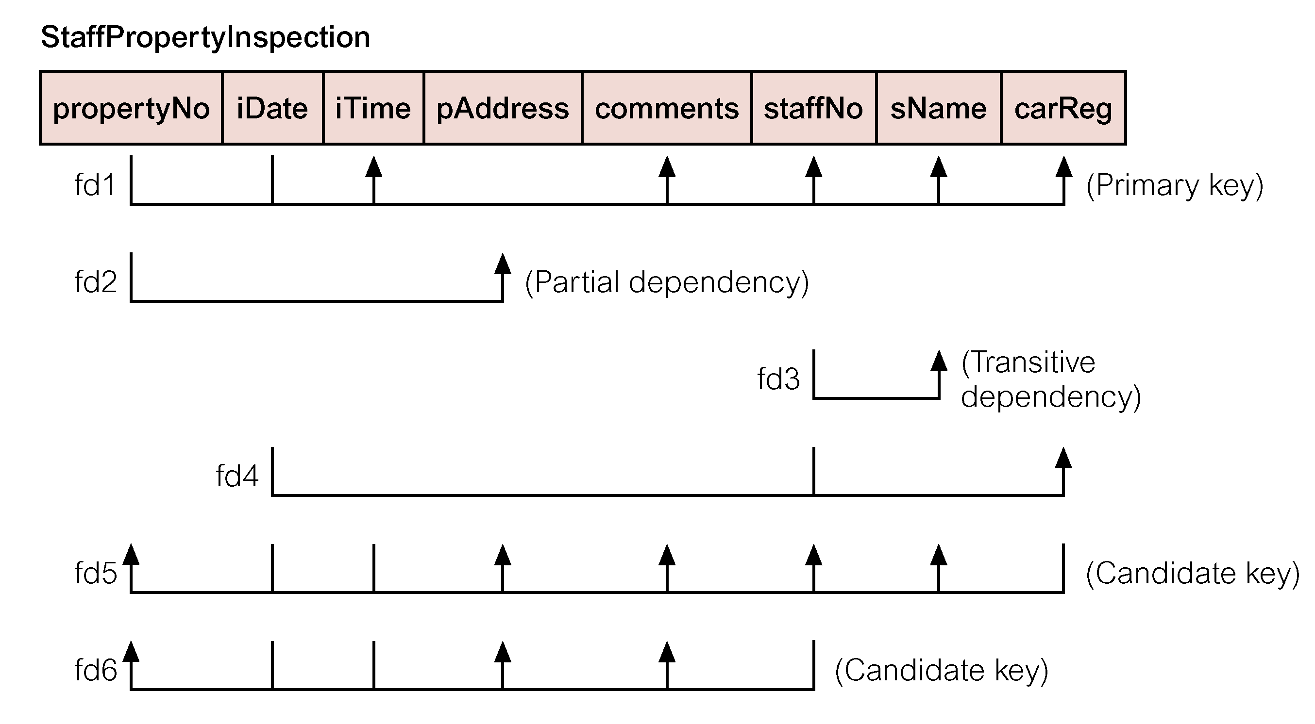
Review of Normalization (UNF to BCNF)
Pearson Education © 2009

Slide 20
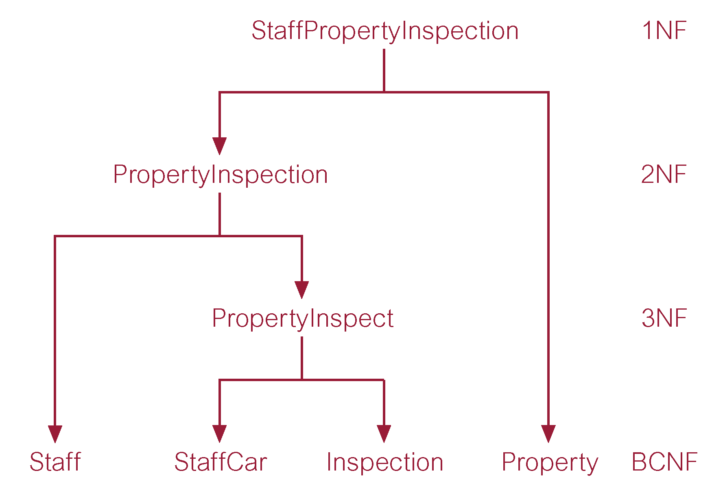
Review of Normalization (UNF to BCNF)
Pearson Education © 2009

Slide 21
Fourth Normal Form (4NF)
Although BCNF removes anomalies due to functional dependencies, another type of dependency called a multi-valued dependency (MVD) can also cause data redundancy.
Possible existence of multi-valued dependencies in a relation is due to 1NF and can result in data redundancy.
Pearson Education © 2009

Slide 22
Fourth Normal Form (4NF)
Multi-valued Dependency (MVD)
Dependency between attributes (for example, A, B, and C) in a relation, such that for each value of A
there is a set of values for B and a set of values for C.
However, the set of values for B and C are independent of each other.
Pearson Education © 2009

Slide 23
Fourth Normal Form (4NF)
MVD between attributes A, B, and C in a relation using the following notation:
A −>> B
A −>> C
Pearson Education © 2009

Slide 24
Fourth Normal Form (4NF)
A multi-valued dependency can be further defined as being trivial or nontrivial.
A MVD A −>> B in relation R is defined as being trivial if (a) B is a subset of A or (b) A ∪ B = R.
A MVD is defined as being nontrivial if neither (a) nor (b) are satisfied.
A trivial MVD does not specify a constraint on a relation, while a nontrivial MVD does specify a constraint.
Pearson Education © 2009

Slide 25
Fourth Normal Form (4NF)
Defined as a relation that is in Boyce-Codd Normal Form and contains no nontrivial multi-valued dependencies.
Pearson Education © 2009

Slide 26
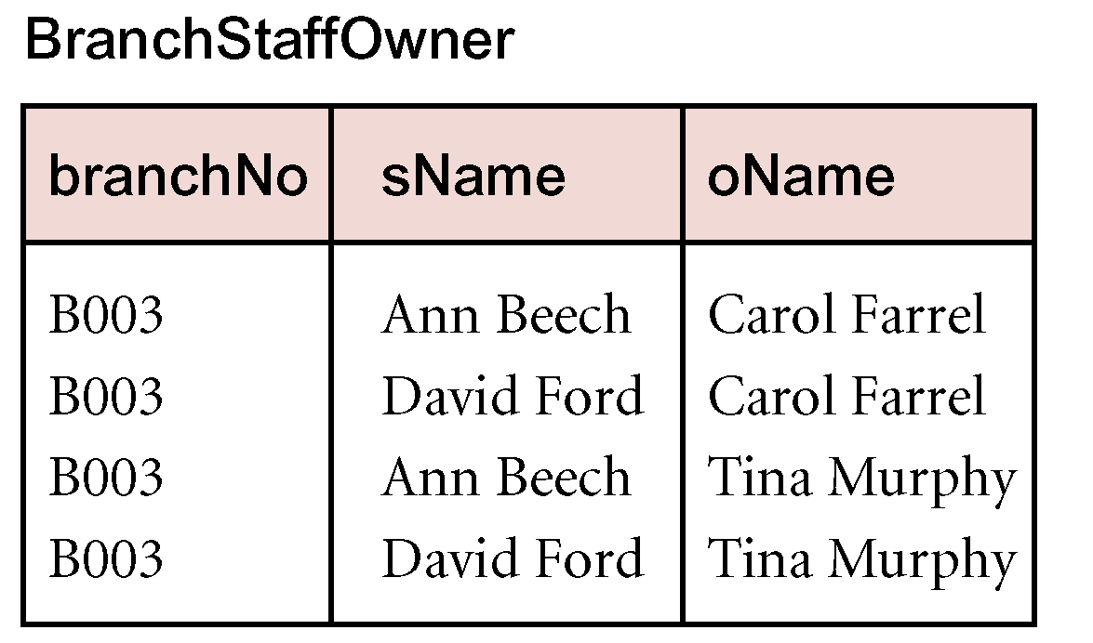
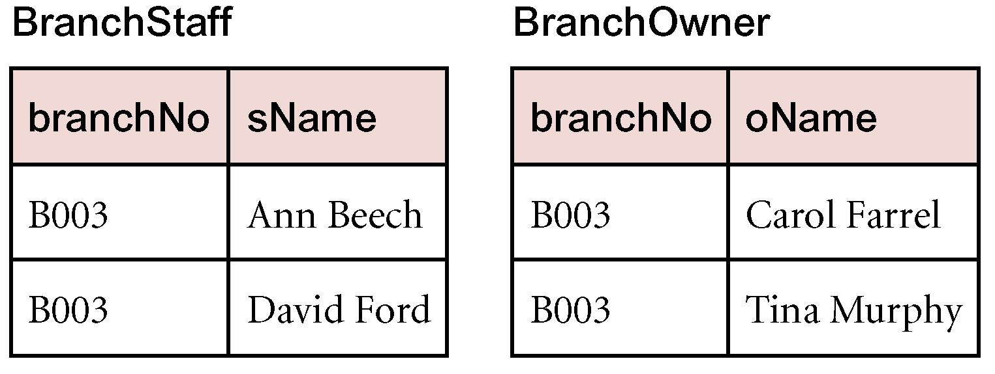
4NF - Example
Pearson Education © 2009

Slide 27
Fifth Normal Form (5NF)
We will omit fifth normal form.
Pearson Education © 2009

